Slide 1

CSE 491:CLOUD COMPUTING
Storage Systems
Jannatun Noor
Lecturer,
BRAC University
Jannatun.noor@bracu.ac.bd

Slide 2
Major Storage architecture
DAS (Direct Attached Storage)
NAS (Network Attached Storage)
SAN (Storage Area Networks)

Slide 3
SAN and network-attached storage (NAS) are both network-based storage solutions. A SAN typically uses Fibre Channel connectivity, while NAS typically ties into to the network through a standard Ethernet connection. A SAN stores data at the block level, while NAS accesses data as files

Slide 4
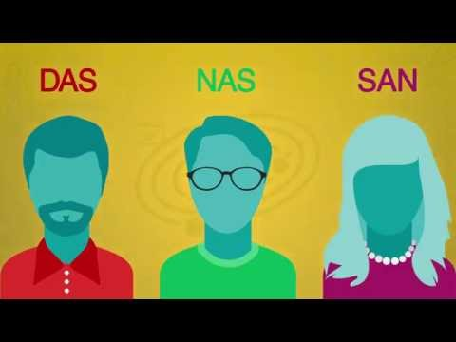

Slide 5
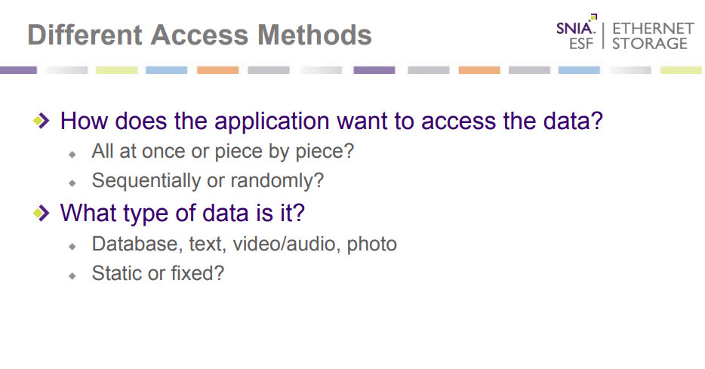

Slide 6
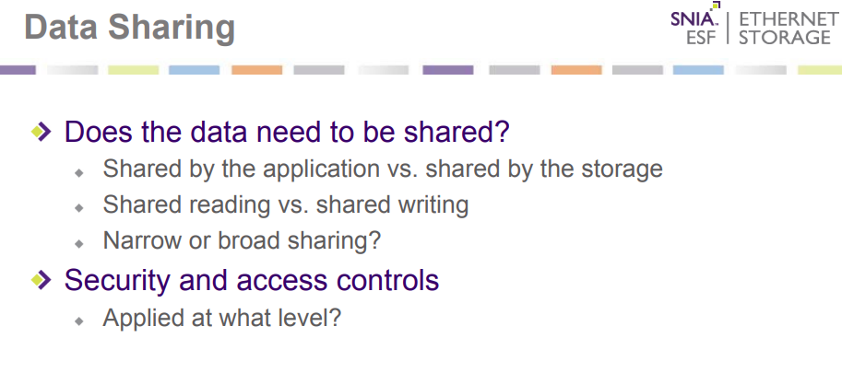

Slide 7
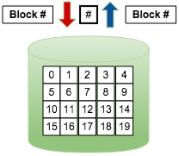
Available Storage System
Block Storage
Data organized as an array of unrelated blocks
When appropriate blocks are combined, it creates a file
No metadata
Strongly Consistent
Used for performance-centric applications, mostly transactional and database-oriented
Followed SAN

Slide 8
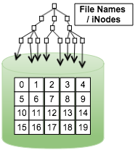
Available Storage System
File Storage
A hierarchical way of organizing files so that an individual file can be located by describing the path to that file
NAS is the best way to share files securely among users on a LAN but not so well if the users are across a WAN
File Systems work well with hundreds of thousands, and perhaps millions, of files but are not designed to handle billions of files

Slide 9
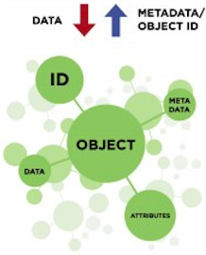
Available Storage System cont.
Object Storage
A new data access, data storage and data management model
API access to data
Metadata-driven, Policy based, Self Managing storage
No host overhead for storage functions
A system that stores virtual containers that encapsulate the data, data attributes, metadata and Object IDs
Easily Scalable
Eventual Consistency
Fault-tolerant

Slide 10


Slide 11
References:
https://www.youtube.com/watch?v=bpUzGZLO948
https://www.youtube.com/watch?v=KduoinBNru4
https://www.networkworld.com/article/3256312/what-is-a-san-and-how-does-it-differ-from-nas.html
https://www.snia.org/sites/default/files/ESF/SNIA-Block-File-Object-Storage-Webcast-Final.pdf

